Slide 1
SELENIUM EXCEPTIONS
KARTHIKEYAN s

Slide 2
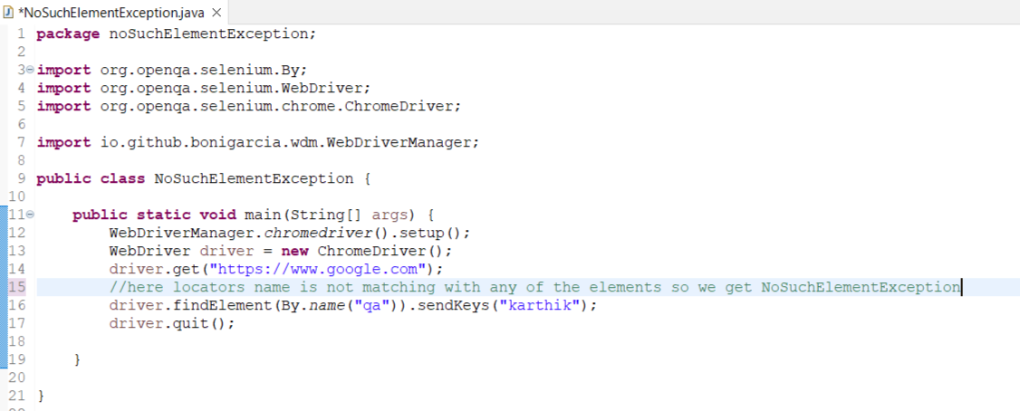
NoSuchElementException (selenium/ unchecked)
We get this exception whenever locators are not matching with any of the elements.

Slide 3
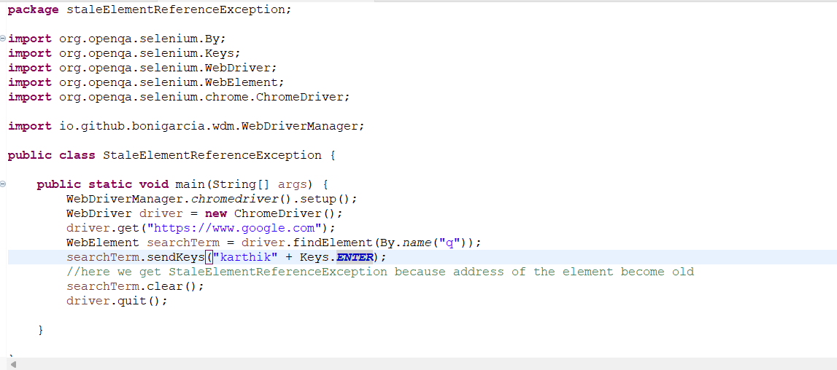
StaleElementReferenceException (selenium/unckecked)
We get this exception whenever the address of the element is old

Slide 4
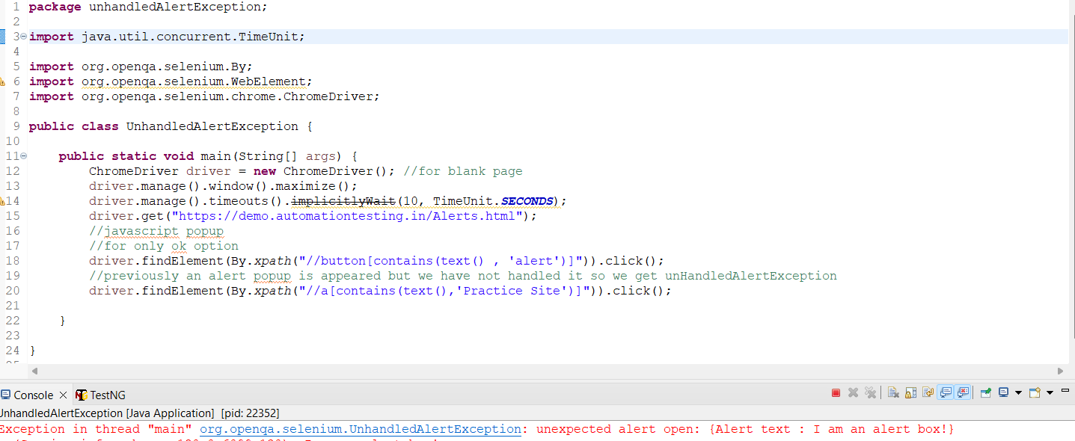
UNHANDLEDALERTEXCEPTION (selenium/unckecked)
We get this exception whenever we try to perform action on the browser without handling alert popup.

Slide 5
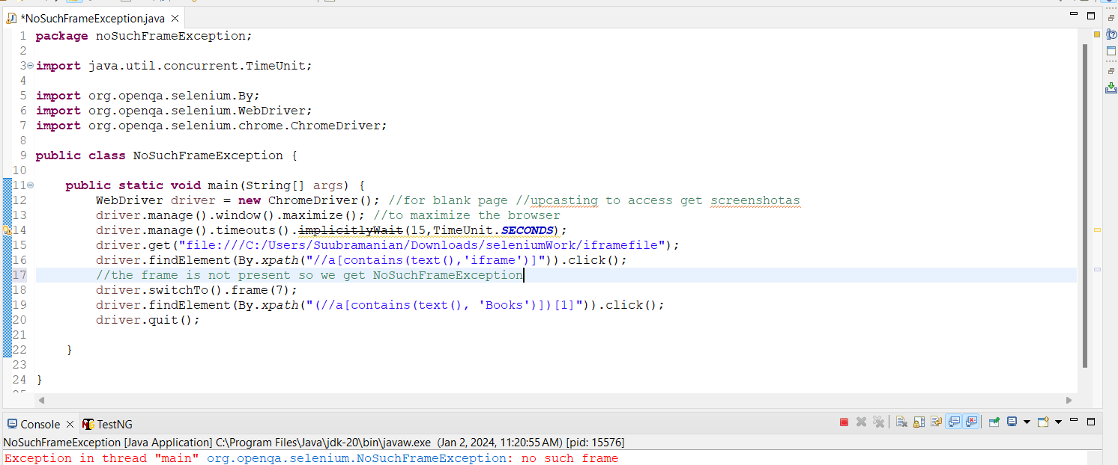
NoSuchFrameException
We get this exception whenever we pass invalid arguments to the frame().

Slide 6
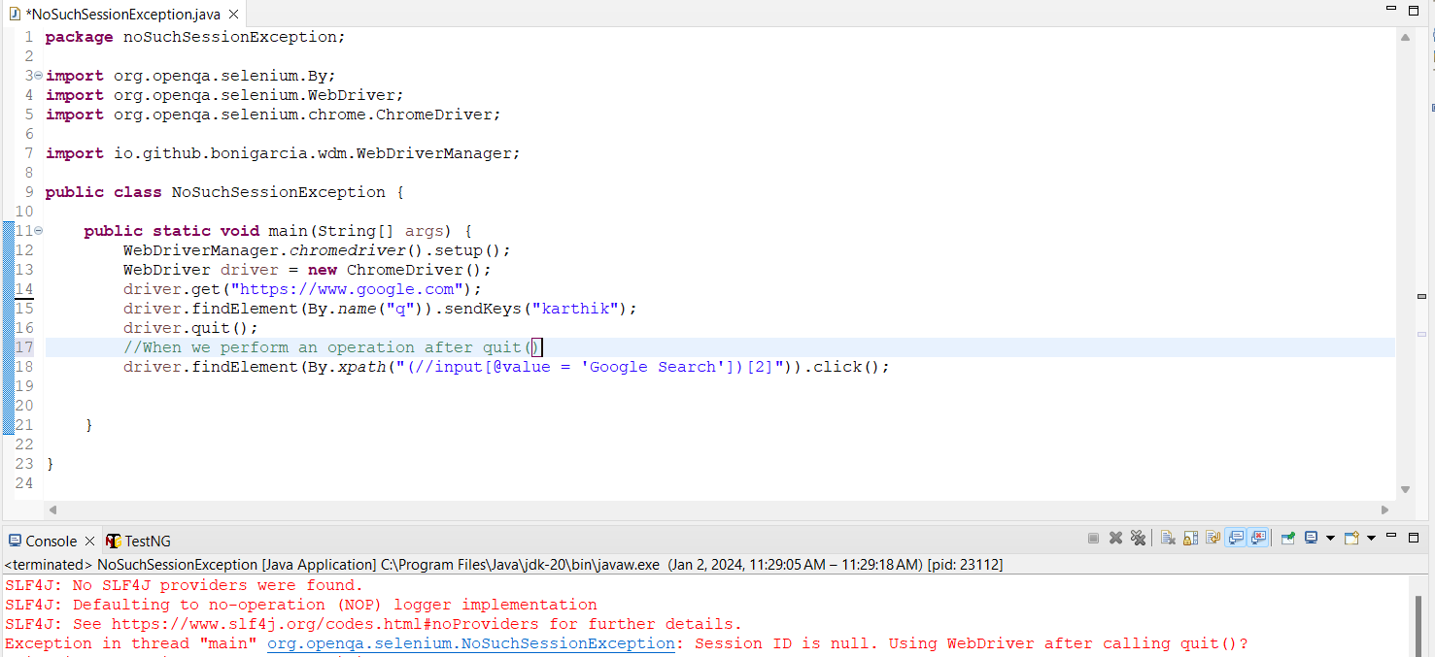
NoSUCHSESSIONEXCEPTION
When you try to perform any operation using the driver once the driver.quit() is called NoSuchSessionException

Slide 7
NoSuchWindowException
We get this exception whenever we try to perform an action on the browser which is already closed(invalid).
ElementNotInteractableException
We get this exception whenever we try to perform action on the disabled elements.

Slide 8
IllegalState Exception (selenium/unchecked)
We get this exception whenever the path of the driver executable file is not set properly.
Interrupted Exception (java/ checked)
We get this exception whenever we use Thread.sleep()

Slide 9
IndexOutOfBoundException (java/unchecked)
We get this exception whenever we pass invalid index value inside the for loop.
InvalidArgumentException (selenium/unchecked)
We get this exception whenever we pass the wrong path of the file.

Slide 10
AWTException (java/checked)
We get this exception whenever we use Robot class.
IOException (java/checked)
We get this exception whenever we use a runtime class or whenever we try to open any files.

Slide 11
SessionNotCreatedException (selenium/unchecked)
We get this exception whenever the driver executable version is not matching with the browser version.
FileNotFoundException (java/checked)
We get this exception whenever we use FileInputStream class.

Slide 12
InvalidSelectorException (selenium/unchecked)
We get this exception whenever there is a syntax error or syntax mistake In cssSelector() or xpath()
NoAlertPresentException (selenium/unchecked)
We get this exception whenever we try to handle the alert popup when the popup itself is not present.

Slide 13
EncryptedDocumentException (apache/checked)
We get this exception whenever we try to read data from the excel file or whenever we use the WorkbookFactory class.
TestNGException (TestNG/ unchecked)
We get this exception whenever tests depend on each other

